Slide 1
Why visualize?

Slide 2


Slide 3
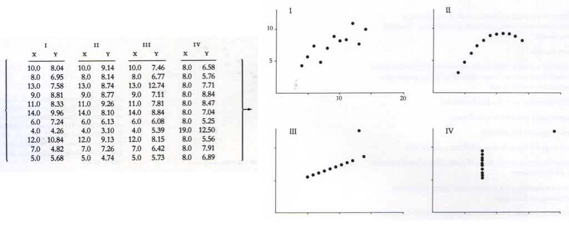
Anscombe’s Quartet
N = 11
Mean of X = 9
Mean of Y = 7.5
Variance of X = 11
Variance of Y = 4.1
Cor(X,Y) = 0.816

Slide 4
Anscombe’s Quartet

Slide 5
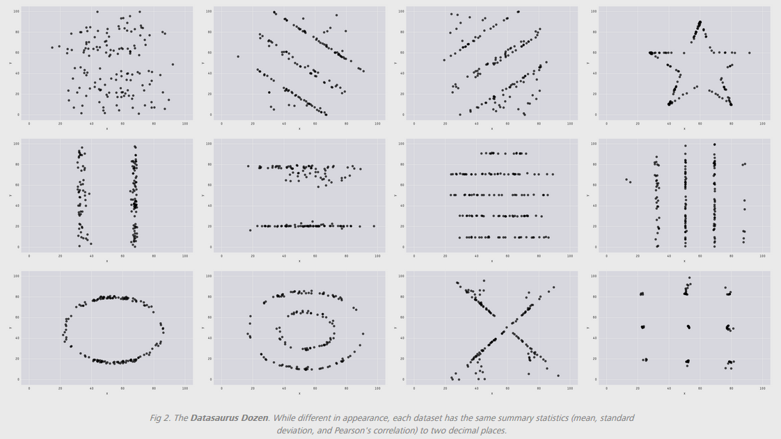
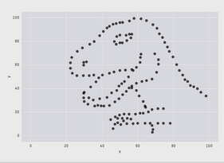
Datasaurus dozen
E(X) = 54.26; E(Y) = 47.83; SD(X) = 16.76; SD(Y) = 26.93; Cor(X,Y) = -0.06
Justin Matejka & George Fitzmaurice: https://www.autodeskresearch.com/publications/samestats

Slide 6
Principles of effective data visualization

Slide 7
What is an effective graph?
An effective graph encodes quantitative information in a way that allows viewers to quickly and easily decode the information.
(Naomi Robbins, Creating More Effective Graphs, p6, paraphrased)

Slide 8
For each of the following graphs:
What information is encoded in the visualization?
What information is easy to extract?
What information is difficult to extract?
What could be done to improve the readability of the visualization?

Slide 9
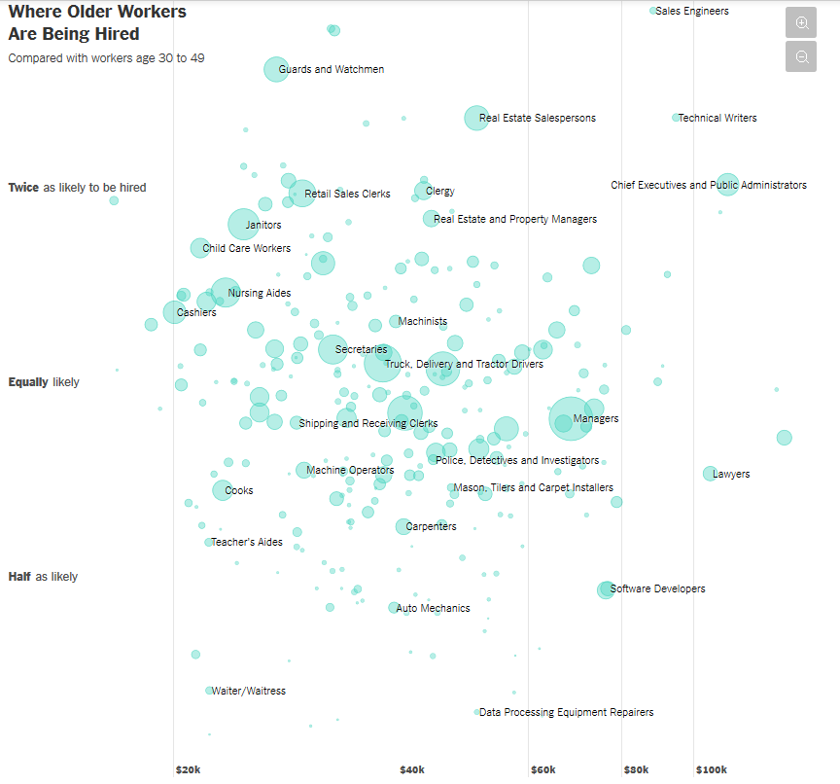
Graph 1
http://nyti.ms/2pC2HZv

Slide 10
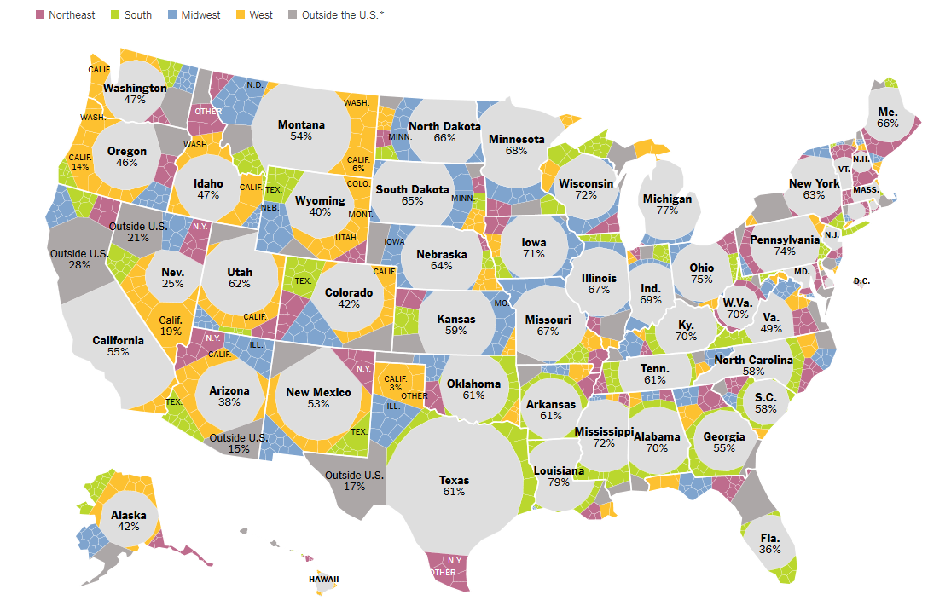
Graph 2
http://nyti.ms/2qwlIS6

Slide 11
How to make effective graphs?

Slide 12
1. Understand how we perceive differences

Slide 13
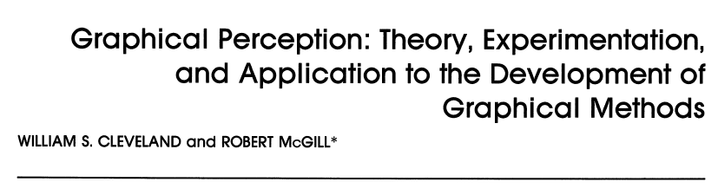

http://bit.ly/2q6aNgY

Slide 14
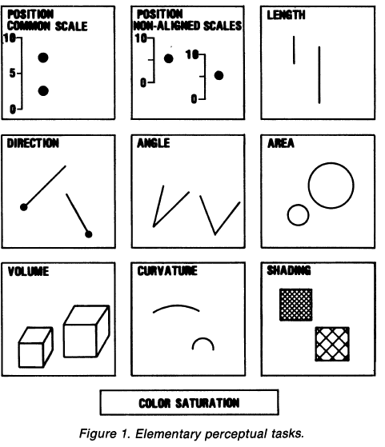
Elementary Perceptual Tasks (EPTs)
Cleveland & McGill, p532

Slide 15
Which represents the larger value? Which EPT did you use?
From Stat 405 notes by Hadley Wickham

Slide 16
Which represents the larger value? Which EPT did you use?
From Stat 405 notes by Hadley Wickham

Slide 17
Hue
Saturation
Value
HSV: 3 dimensions of color

Slide 18
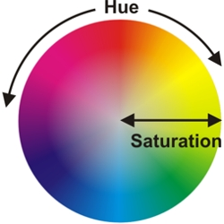

Slide 19

https://chroma.readthedocs.io/en/latest/

Slide 20
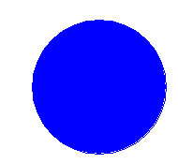

Saturation = 1, Value = 1
Hue = 2/3
Hue = 0

Slide 21

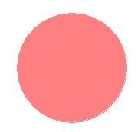
Hue = 0, Value = 1
Saturation = 0.2
Saturation = 0.5
Saturation = 1

Slide 22


Hue = 0, Saturation = 1
Value = 0.5
Value = 0.8
Value = 1

Slide 23


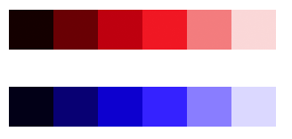
Issues with HSV
6 hues, same value, different perceived lightness:
Converting to grayscale:
Equidistant changes in value not created equal; red step appears much more drastic than blue step:
https://www.vis4.net/blog/posts/avoid-equidistant-hsv-colors/

Slide 24

Hue Chroma Luminance
6 hues on HSV scale; same saturation and value:
Same hues using HCL scale; same chroma and luminance:
https://www.vis4.net/blog/posts/avoid-equidistant-hsv-colors/

Slide 25
2. Match EPTs to data type (quantitative, ordinal, nominal)

Slide 26
Which represents the larger value? Which EPT did you use?

Slide 27
Which represents the larger value? Which EPT did you use?

Slide 28
Which represents the larger value? Which EPT did you use?

Slide 29
Which represents the larger value? Which EPT did you use?

Slide 30
EPT | Ordered? | Appropriate for:
Position | Yes | Quantitative, ordinal, nominal
Size (length, angle, volume) | Yes | Quantitative, ordinal, nominal
Saturation (color ramp) | Yes | Quantitative, ordinal, nominal
Value (gray ramp) | Yes | Quantitative, ordinal, nominal
Hue | No | Nominal only
Shape | No | Nominal only

Slide 31
3. Exploit our most efficient EPTs

Slide 32
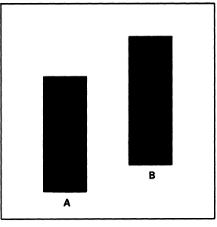
Which quantity is largest?
Which EPT are you using?
From Cleveland and McGill, p 538

Slide 33
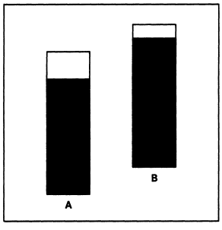
Which quantity is largest?
Which EPT are you using?
From Cleveland and McGill, p 538

Slide 34
Better yet…

Slide 35
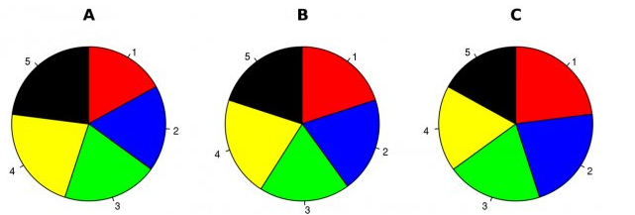
Hypothetical polling data on 5 candidates at initial time point A.
Rank the candidates in terms of their share of the vote.
Which EPT are you using?
Walter Hickey at Business Insider

Slide 36
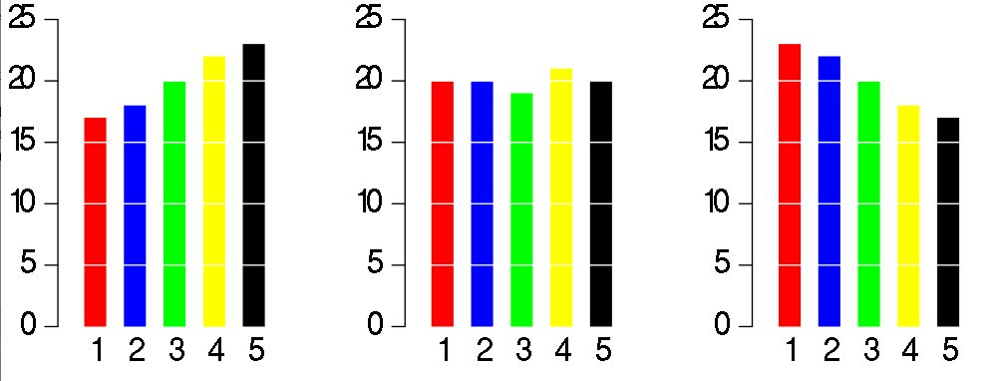
Same data, different graph
Which EPT are you using now?
Walter Hickey at Business Insider

Slide 37
Back to Cleveland and McGill…what is the size of Quantity A relative to Quantity B?
a
b
Figures revised by Hadley Wickham

Slide 38
What about now?
a
b
Figures revised by Hadley Wickham

Slide 39
What about now?
a
b
Figures revised by Hadley Wickham

Slide 40
What about now?
b
a
Figures revised by Hadley Wickham

Slide 41
What about now?
b
a
Figures revised by Hadley Wickham

Slide 42
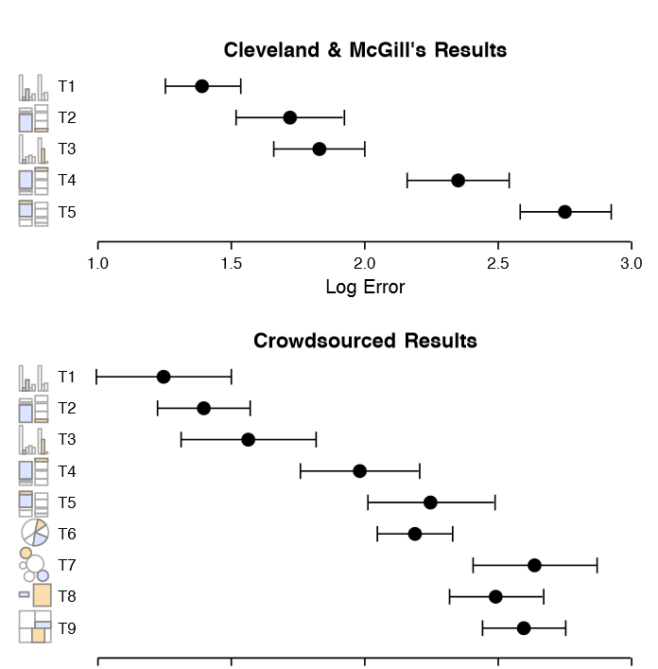
J. Heer and
M. Bostock. Crowdsourcing graphical perception: Using mechanical turk to assess visualization design. In CHI 2010, 2010.

Slide 43
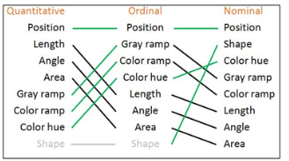

Value
Saturation
Hue
From Ben Jones, Visualizing Data with Tableau, p9

Slide 44
4. Make important comparisons easy
The way you group is important

Slide 45
Back to the 5 hypothetical candidates at 3 time points:
Walter Hickey at Business Insider

Slide 46
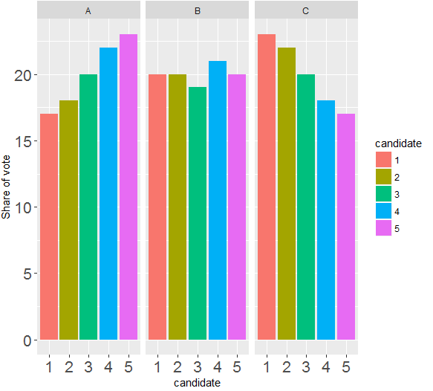
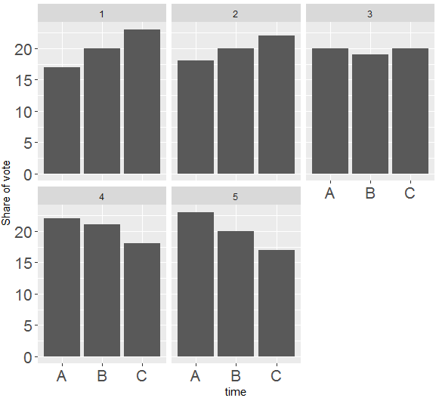
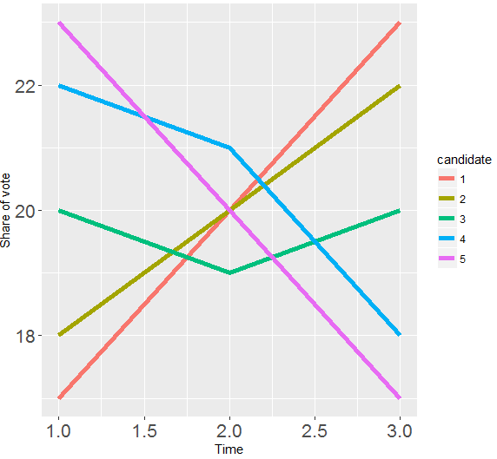
Alternative takes:
In groups;
What are the variables (think: data columns)?
For each graph, which EPTs are used to map the variables?
Which graph(s) have redundant EPTs?
Which graph(s) should be used to answer which candidate is doing the worst at Time B? Why?
Which graph(s) should be used to answer candidates are losing steam? Why?
Which graph(s) should be used to answer which candidate has the most momentum in the race? Why?

Slide 47
Given what you know now, take a look at the following vizzes.
In groups;
What are the “cases” (data rows)?
What are the variables (data columns)?
For each graph, which EPTs are used to map the variables?
Are the EPT choices appropriate?
Are the EPT choices effective?
Are important comparisons made easy?

Slide 48
Graph 1
http://nyti.ms/2pC2HZv

Slide 49
Graph 2
http://nyti.ms/2qwlIS6

Slide 51

Napoleon’s march on Moscow, 1812
“It may well be the best statistical graphic ever drawn” –Ed Tufte

Slide 52
Design principles

Slide 53
1. Mind the data-to-ink ratio

Slide 54

Ed Tufte: the EPT minimalist
Professor Emeritus: Yale University
Statistician, political scientist, computer scientist, power point hater
Early pioneer of data visualization theory

Slide 55
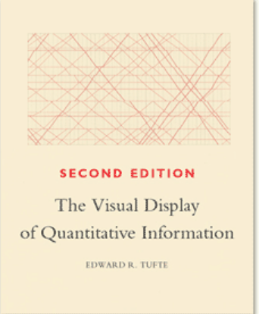
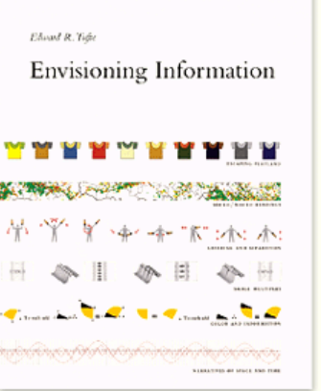
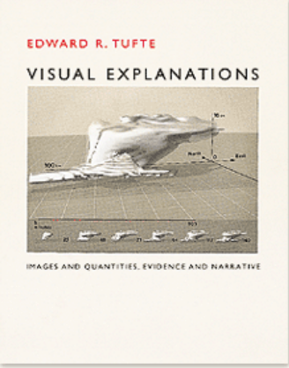


Slide 56
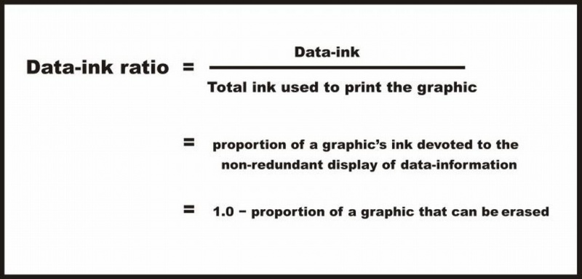
Data-to-Ink Ratio
Ratio of Data-Ink to non-Data-Ink
The proportion of Ink that is used to present actual data compared to the total amount of ink (or pixels) used in the entire display:
“Good displays” = displays with D-t-I ratios close to 1
http://www.infovis-wiki.net/index.php/Data-Ink_Ratio

Slide 57
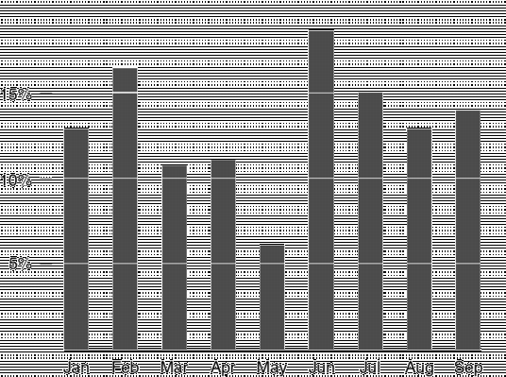
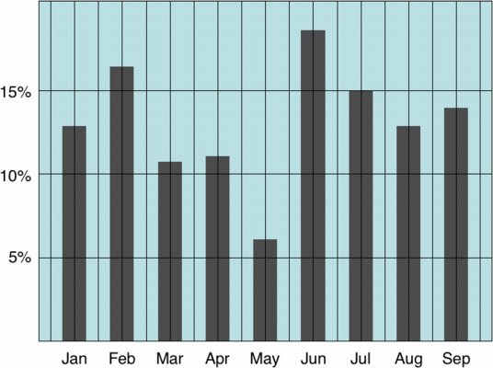
Data-to-Ink Ratio
Low...
…High
http://www.infovis-wiki.net/index.php/Data-Ink_Ratio

Slide 58
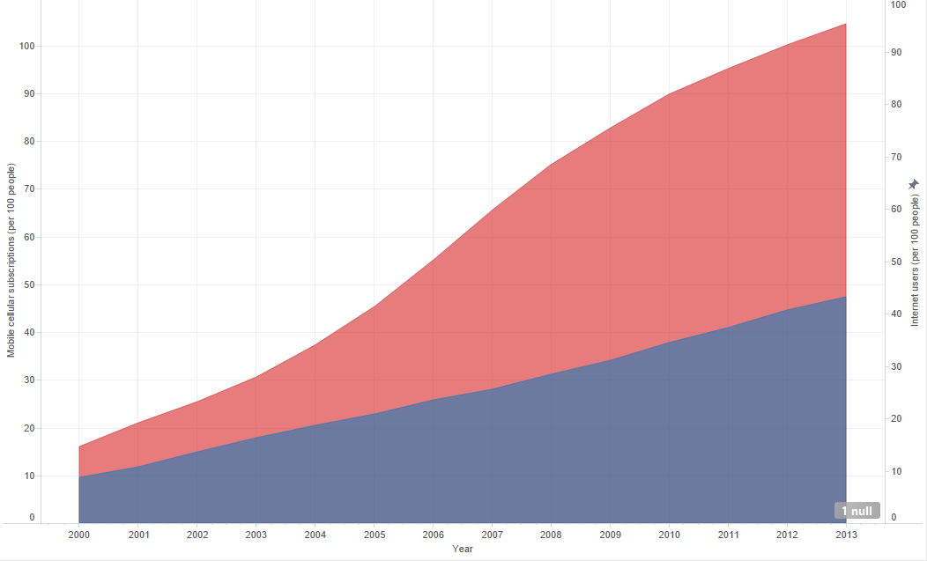
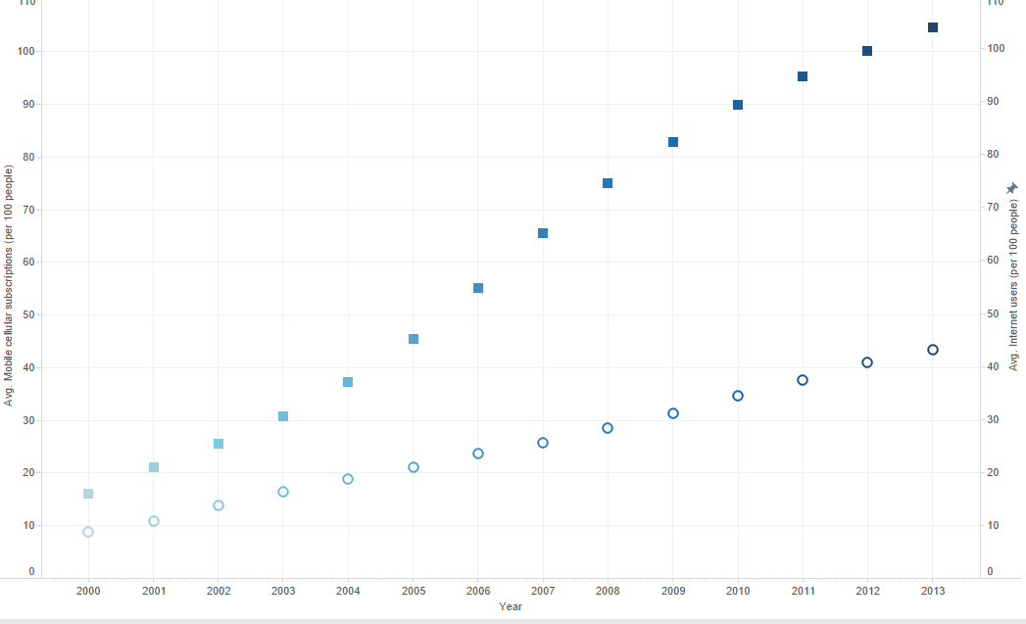
Data-to-Ink Ratio
Low...
…High

Slide 59
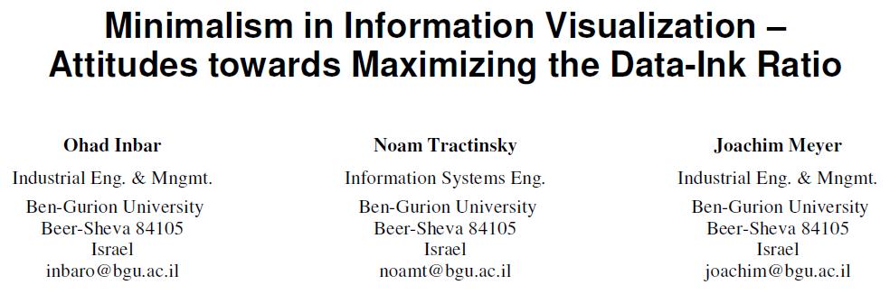
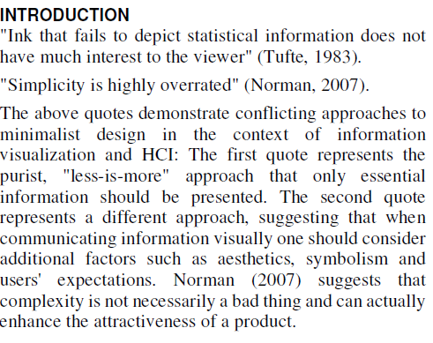

Slide 60
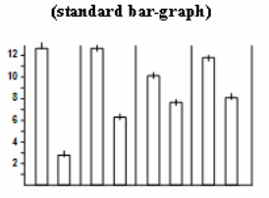
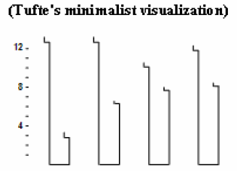
87 undergraduate students asked to decide which is more “beautiful”, “clear”, and “simple”.
Graphs taken from Tufte’s Visual Display of Quantitative Information (1983)

Slide 61
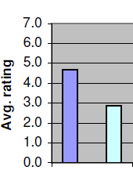
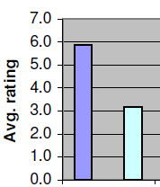
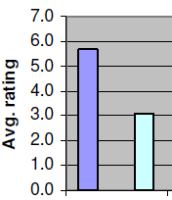
Beautiful
Clear
Simple
Standard
Tufte
Standard
Tufte
Standard
Tufte

Slide 62

Minimalism
YOU
Elegance/
attractiveness

Slide 63
2. Know your message:
It is not the same as information

Slide 64
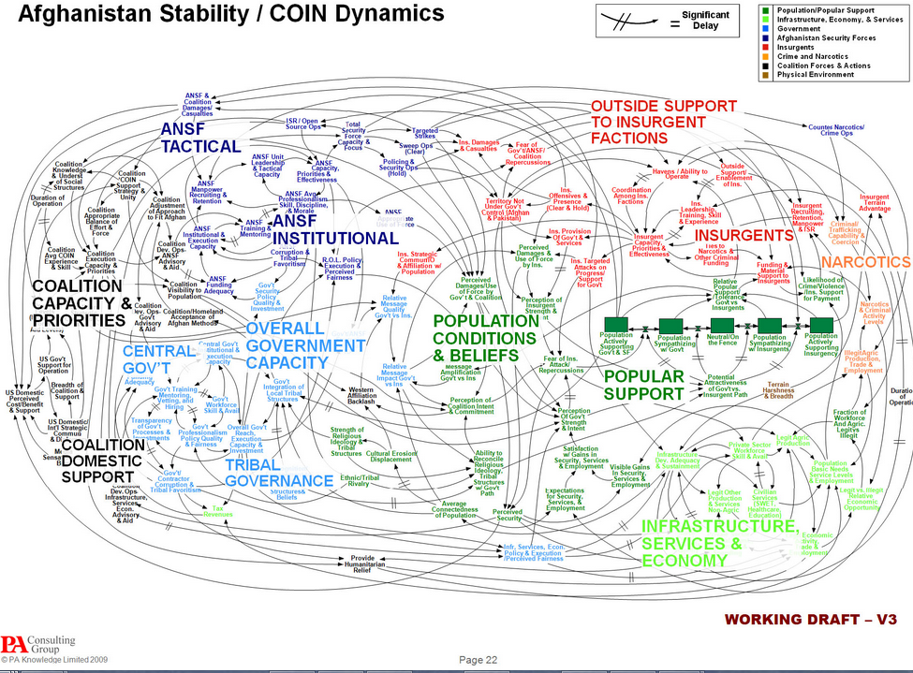

Slide 65
3. Use the right data

Slide 66
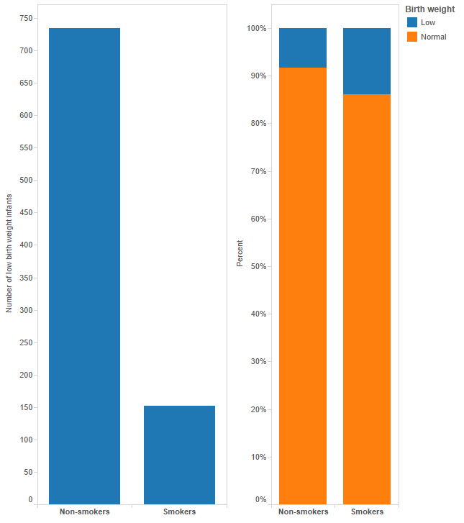

Slide 67
4. Design for aesthetics
…while avoiding “chart junk”

Slide 68
Some tips for aesthetics
Avoid poor color schemes
Watch the axes and labels: Readable? Consistent?
Use the same fonts
Don’t accept software defaults

Slide 69
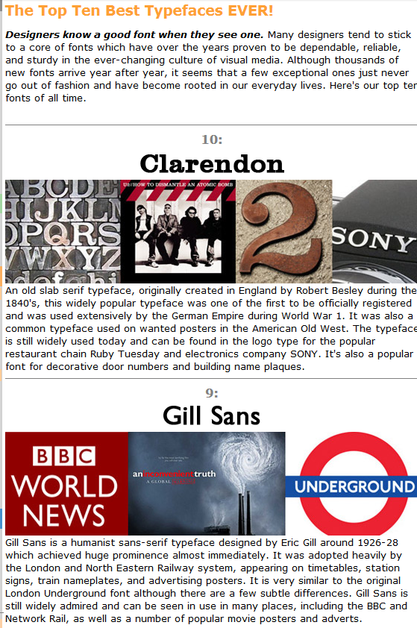
The best and worst fonts:
Link 1
Link 2

Slide 70
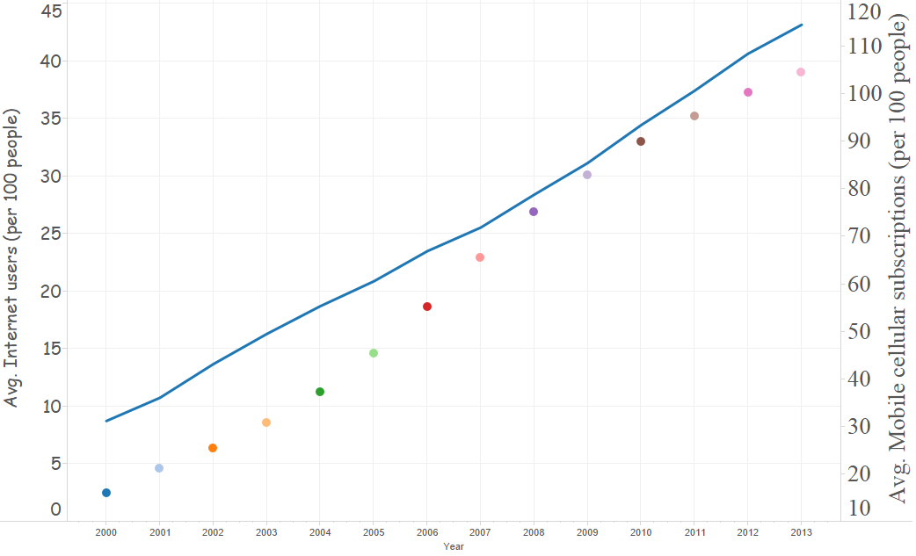
Find the aesthetic perks and pitfalls

Slide 71
5. Don’t deceive

Slide 72
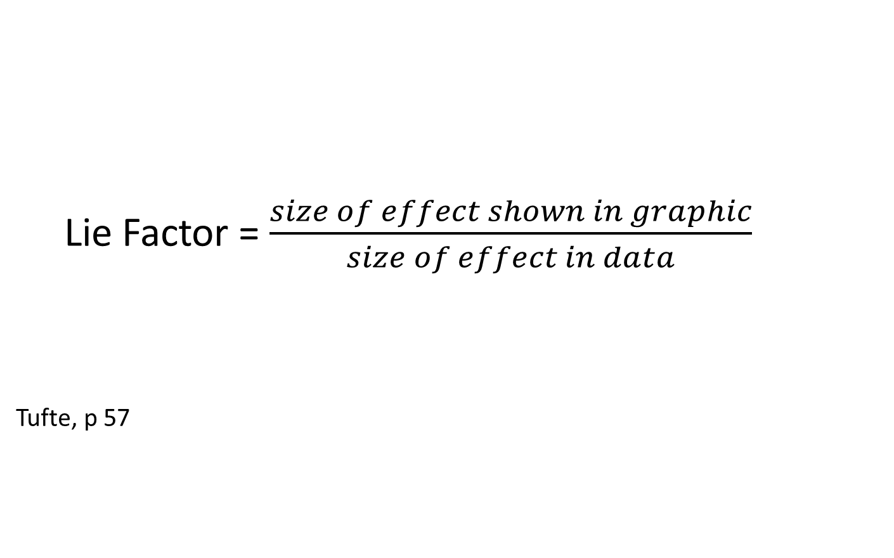
Lie Factor = $\frac{size of effect shown in graphic}{size of effect in data}$
Tufte, p 57

Slide 73
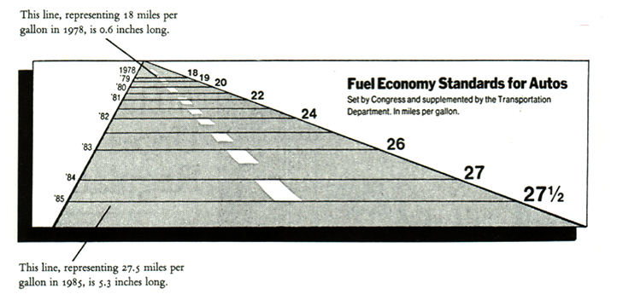
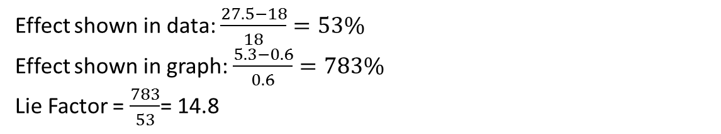
Effect shown in data: $\frac{27.5−18}{18}=53\%$
Effect shown in graph: $\frac{5.3−0.6}{0.6}=783\%$
Lie Factor = $\frac{783}{53}$= 14.8

Slide 74
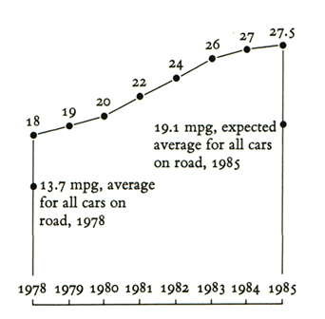

Slide 75
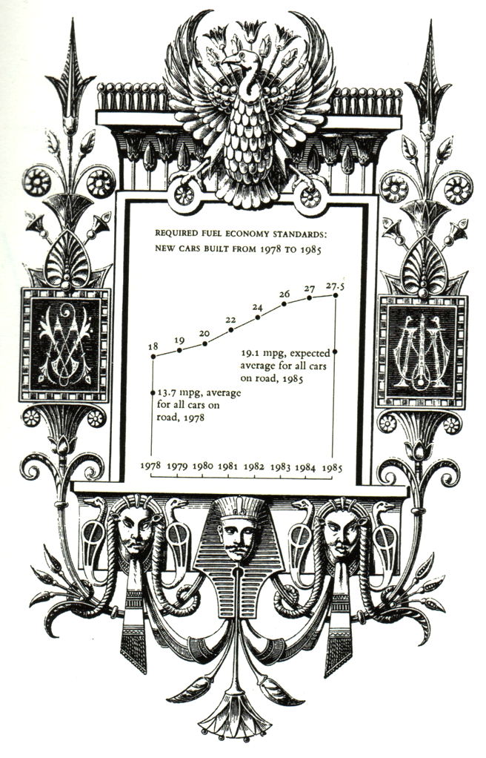
“Many decorations but no lies”:

Slide 76
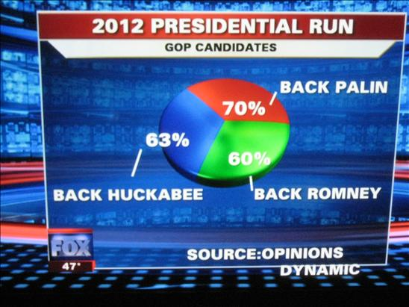

Slide 77

Source

Slide 78
Tufte’s Principles of Graphical Excellence
Graphical excellence is the well-designed presentation of interesting data – a matter of substance, of statistics, and of design.
Graphical excellence consists of complex ideas communicated with clarity, precision, and efficiency.
Graphical excellence is that which gives to the viewer the greatest number of ideas in the shortest time with the least ink in the smallest space.
Graphical excellence is nearly always multivariate.
And graphical excellence requires telling the truth about data.
Tufte, p 51

Slide 79
TASKS FOR TOMORROW
Find two visualizations, one that you think is ‘effective’ and one that ‘needs substantial improvement.’ For each:
State the “cases” (data rows): is there aggregation or not?
State the variables, and what EPTs are used to map the variables
State why you think each visualization is ‘effective’ and what about each could be improved.

Slide 80
References & Resources
Cleveland, William S. The elements of graphing data. Monterey, CA: Wadsworth Advanced Books and Software, 1985.
Cleveland, William S., and Robert McGill. "Graphical perception: Theory, experimentation, and application to the development of graphical methods." Journal of the American statistical association 79:387 (1984): 531-554.
Robbins, Naomi B. Creating more effective graphs. Chart House, 2013.
Tufte, Edward. The Visual Display of Quantitative Information. Graphics Press; 2nd edition. 1983.

